Slide 1



Classification of Hand Movements from sEMG signals
Presenter:
Neil Kennedy, Adi Shastry, Shahad Albrahim
12/20/2021
Notes:
Hi, this is Neil, Adi , and Shahad
For our final project, we decided on classifying Hand Movements using surface EMG data
1

Slide 2
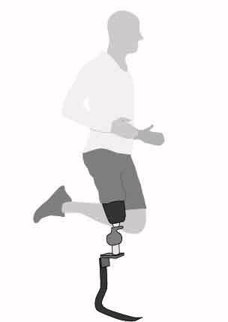
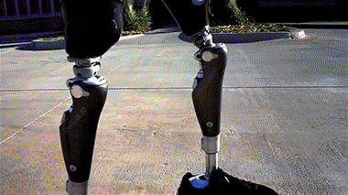
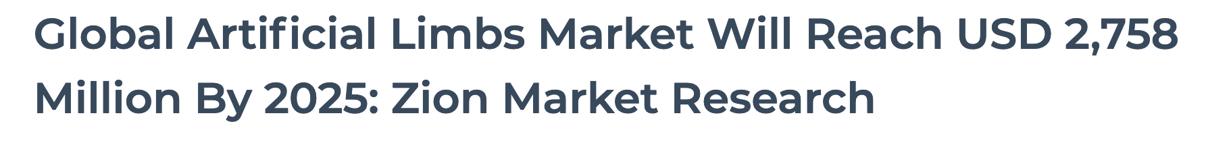
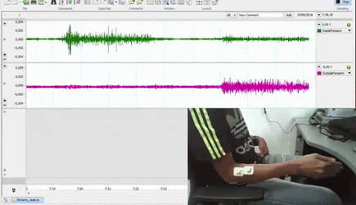
Introduction
2 | BMEN 4470
Notes:
With an expected market cap of 2.8 Billion by 2025, it is clear that prosthetics will be a major part of the next few years of biomedical innovation
Traditional prosthetic limbs, and ones generally available to the public, are almost exclusively mechanically powered and actuated. This traditional approach has been known to be very uncomfortable, not intuitive, does not provide natural use of the limb, among many other issues.
To address this issue, many researchers and companies have developed solutions to use computerized control to create more complex and dynamic systems that can better resemble human anatomy and make the transition to using the prosthetic limb easier.
However the biggest issue in this area is the ability of electrical and computer controlled systems to interface with the human body. In this paper we aim to experiment with various deep learning architectures to see which is best suited to analyse EMG gesture data from the putEMG data set.
2

Slide 3
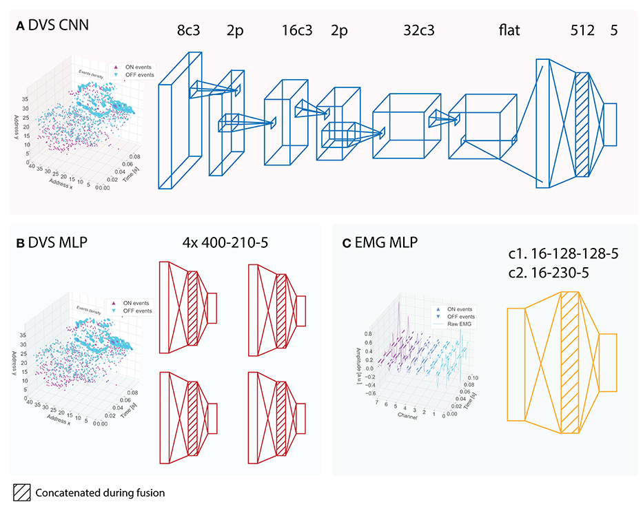
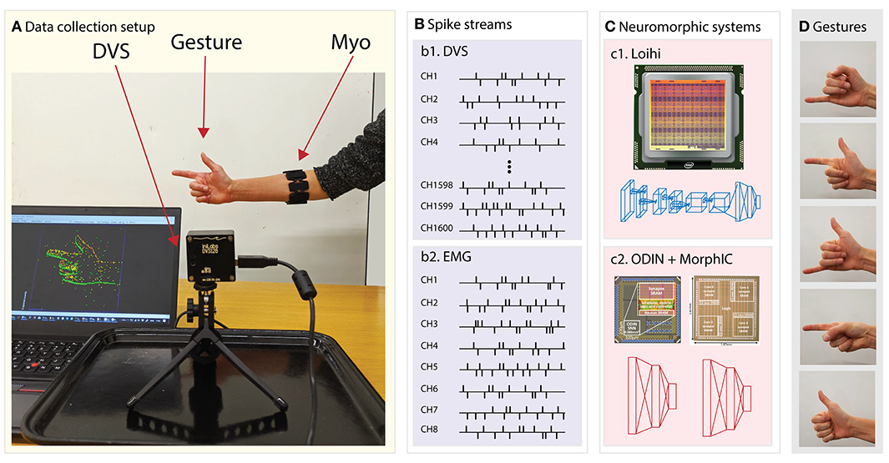
Prior Works
3 | BMEN 4470
Notes:
As a result of the impact that advancements in EMG data processing can have, many researchers have employed various techniques such as traditional feature extraction based on the fundamentals of the EMG signal and human biology, usage of traditional machine learning and statistical techniques, as well as deep learning techniques.
(Image on the left)
One group was able to achieve a 90\% accuracy using the support vector machine (SVM) traditional machine learning model after some feature extraction techniques were used on the raw data to better prime it for the SVM \cite{b1}.
(Image on the right)
Another team was able process EMG data to classify gestures by using spiking neural networks (SNNs) that more closely model biological neurons as compared to artificial neural networks \cite{b4}. With this method of analysing EMG signals, the team was able to accomplish the same accuracy of gesture classification, but with 30 times the efficiency of traditional deep learning models.
3

Slide 4
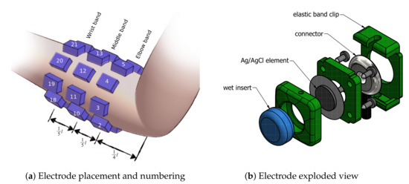
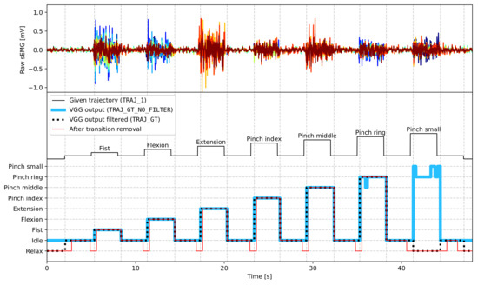
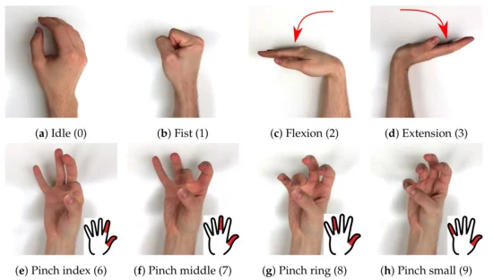
The putEMG Data set
4 | BMEN 4470
Notes:
The putEMG data set consists of 24 channels of sEMG data and a possibility of 9 hand gestures, one being relaxed which is not shown in the image. There were multiple experimental procedures that the team had their subjects complete, however we decided to use the sequential gesture data set for our experiments.
This sequential gesture data set consists of a sequence of 9 gestures which were sequentially held by the subject for 1 or 3 seconds. This sequence of gestures was then repeated a total of seven times with data being collected continously.
Overall, the data set consisted of over 300 million data points for us to analyse. However, given the compute power we had access to on google colab and kaggle, processing the entire data set was not possible.
4

Slide 5
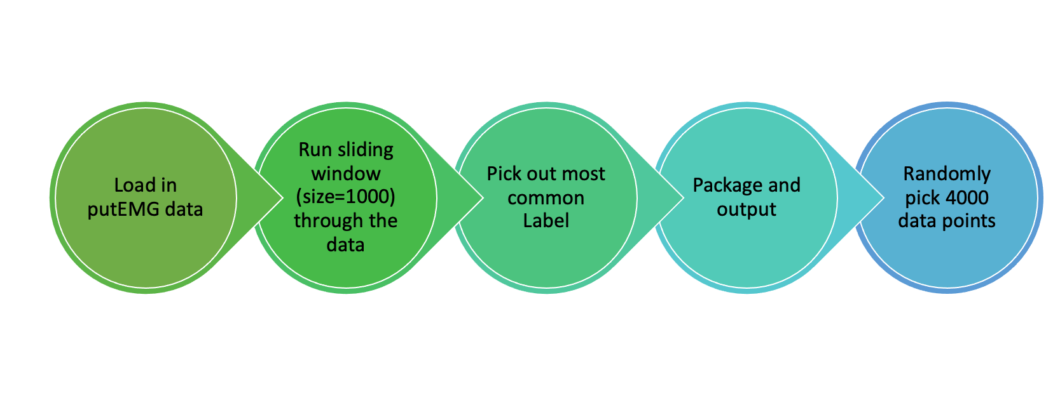
Data Pre-Processing
5 | BMEN 4470
Notes:
In order to pare down the data set as well as build in a temporal dimension into it, the following steps were taken.
The data set was imported and a sliding window of 1000 entries (about 0.195s) in the temporal dimension was separated and stored as a single data point to be used in the deep learning models. Since labels were given at each time step, the most common label in the sliding window was added as the overall label for the data point.
To account for the immense amount of data available in the putEMG data set, a sample of 4000 temporal data points were randomly chosen while keeping in mind the overall balance between the number of data points per label to allow for equal training on all hand gestures.
5

Slide 6
ResNet/TCN
Input
23 x 10,000
Conv1d 128x1
23 x 128
Conv1d 128x1
23 x 128
Batch Norm, Relu
Batch Norm, Relu
Conv1d 128x1
23 x 128
Conv1d 128x1
23 x 128
Batch Norm, Relu
23 x 128
Add
Conv1d 128x1
23 x 128
Max-Pool
7 x 128
Add
23 x 128
Batch Norm, Relu
Flatten
1 x 896
Dense
1 x 10
6 | BMEN 4470
Notes:
Heart disease is one of the most pervasive causes of human death. The diagnosis of heart disease is a challenging task. In a clinical mannar, doctors usually diagnose it based on the morphological waveform of an ECG. The waveforms in an ECG can be divided into time segments measuring particular phases of the cardiac cycle or contraction. The continuous repetitive unit of the cardiac cycle is the “P-QRS-T” waveforms.
However, the diagnosis of heart disease is difficult because of its paroxysmal and complex nature. And it is usually difficult to make a clinical judgement, especially when the signals are mixed with noise.
This leads to the development of machine learning approaches to accurately identify heart disease.
ECG: a time series of data, and a recurrent neural network (RNN) can be used to solve the time-series problem.
Electrocardiogram (ECG): a technique for graphical representation of heart activity over time. An ECG reflects the regularity of the heart’s activity and physiological state of each body part.
ECG is a significant reference for the diagnosis of heart disease.
The waveforms depicted in an EKG can be divided into time segments measuring particular phases of the cardiac cycle or contraction. The continuous repetitive unit of the cardiac cycle is the “P-QRS-T” waveforms.
6

Slide 7
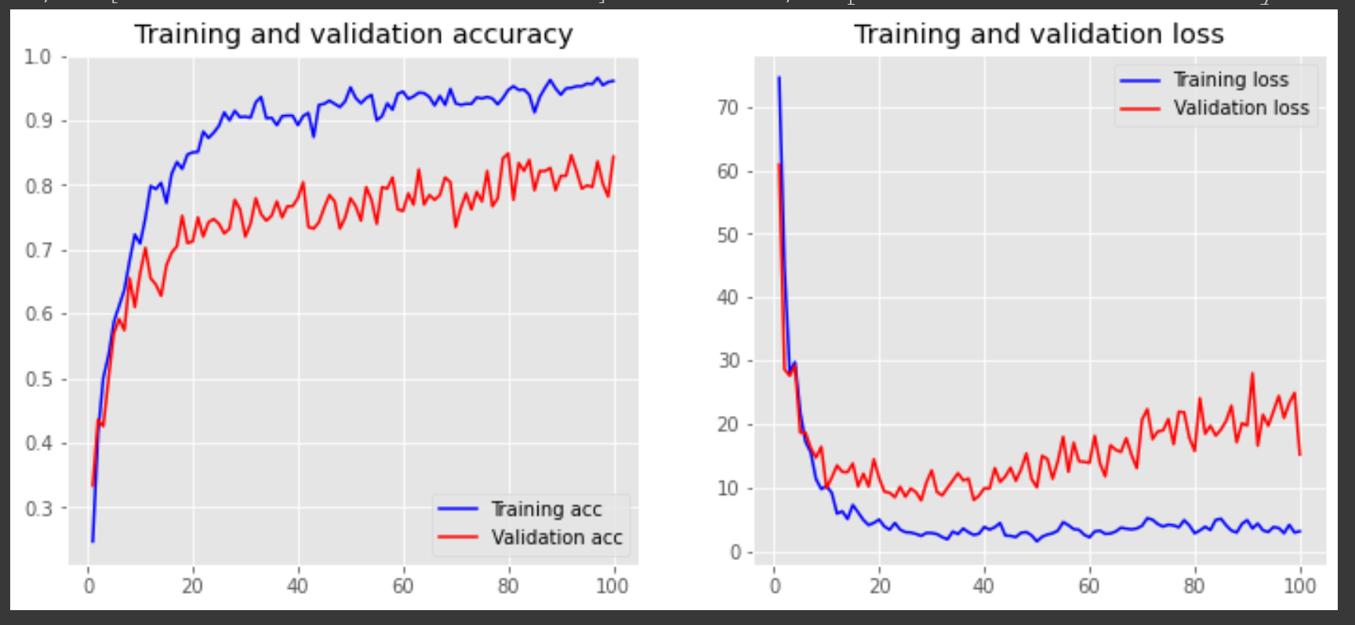
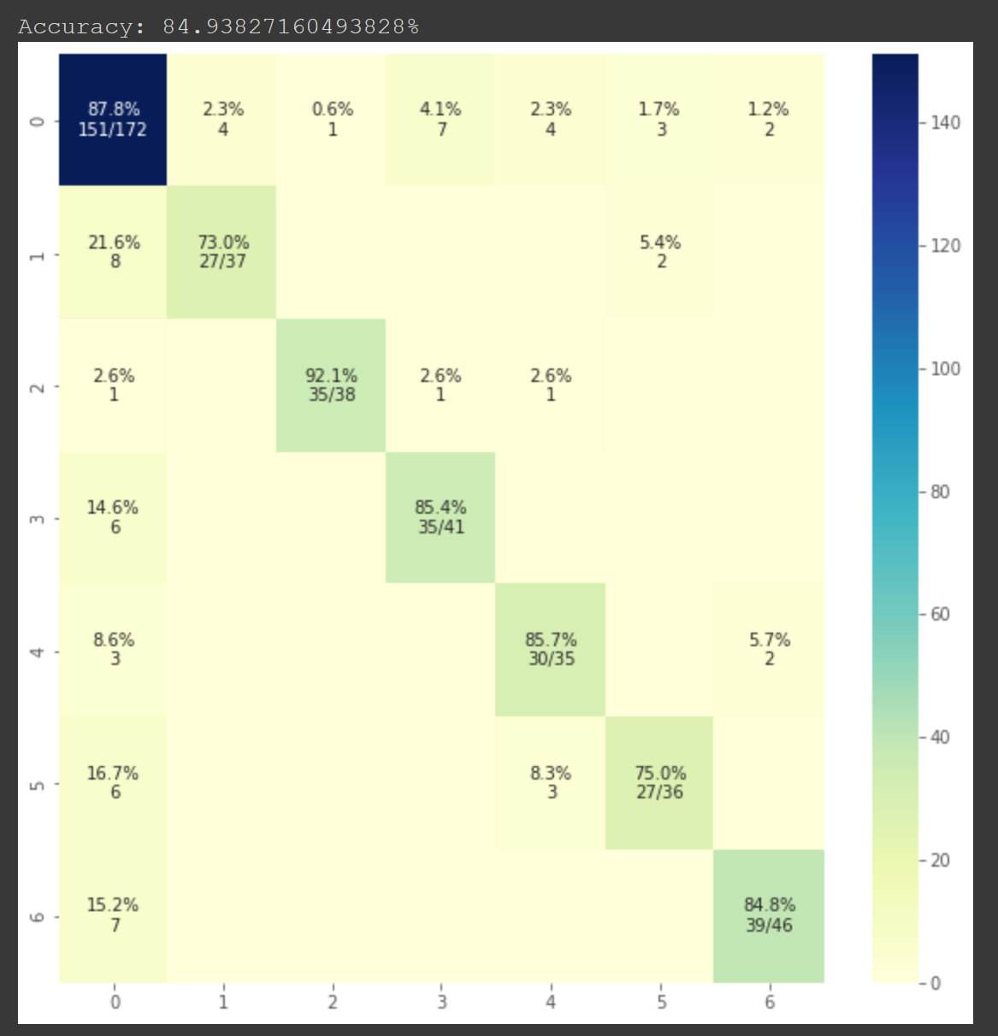
ResNet/TCN
7 | BMEN 4470
Notes:
Heart disease is one of the most pervasive causes of human death. The diagnosis of heart disease is a challenging task. In a clinical mannar, doctors usually diagnose it based on the morphological waveform of an ECG. The waveforms in an ECG can be divided into time segments measuring particular phases of the cardiac cycle or contraction. The continuous repetitive unit of the cardiac cycle is the “P-QRS-T” waveforms.
However, the diagnosis of heart disease is difficult because of its paroxysmal and complex nature. And it is usually difficult to make a clinical judgement, especially when the signals are mixed with noise.
This leads to the development of machine learning approaches to accurately identify heart disease.
ECG: a time series of data, and a recurrent neural network (RNN) can be used to solve the time-series problem.
Electrocardiogram (ECG): a technique for graphical representation of heart activity over time. An ECG reflects the regularity of the heart’s activity and physiological state of each body part.
ECG is a significant reference for the diagnosis of heart disease.
The waveforms depicted in an EKG can be divided into time segments measuring particular phases of the cardiac cycle or contraction. The continuous repetitive unit of the cardiac cycle is the “P-QRS-T” waveforms.
7

Slide 8
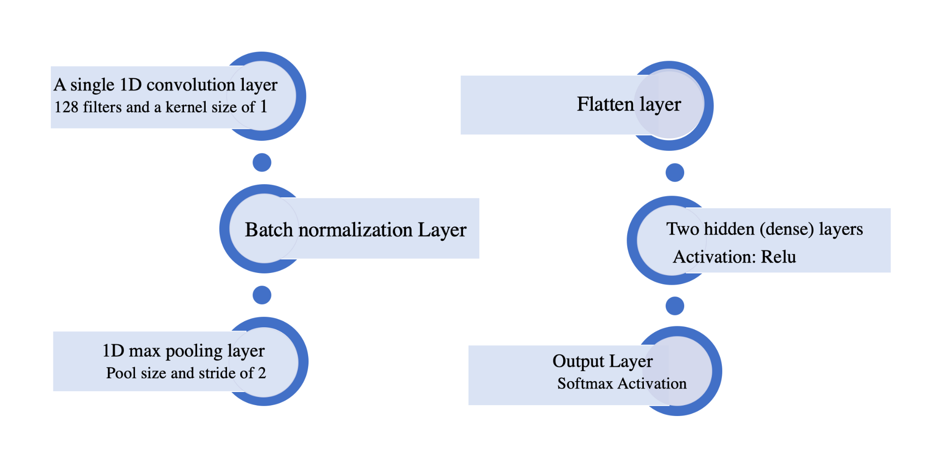
CNN / Design
8 | BMEN 4470
Notes:
Heart disease is one of the most pervasive causes of human death. The diagnosis of heart disease is a challenging task. In a clinical mannar, doctors usually diagnose it based on the morphological waveform of an ECG. The waveforms in an ECG can be divided into time segments measuring particular phases of the cardiac cycle or contraction. The continuous repetitive unit of the cardiac cycle is the “P-QRS-T” waveforms.
However, the diagnosis of heart disease is difficult because of its paroxysmal and complex nature. And it is usually difficult to make a clinical judgement, especially when the signals are mixed with noise.
This leads to the development of machine learning approaches to accurately identify heart disease.
ECG: a time series of data, and a recurrent neural network (RNN) can be used to solve the time-series problem.
Electrocardiogram (ECG): a technique for graphical representation of heart activity over time. An ECG reflects the regularity of the heart’s activity and physiological state of each body part.
ECG is a significant reference for the diagnosis of heart disease.
The waveforms depicted in an EKG can be divided into time segments measuring particular phases of the cardiac cycle or contraction. The continuous repetitive unit of the cardiac cycle is the “P-QRS-T” waveforms.
8

Slide 9
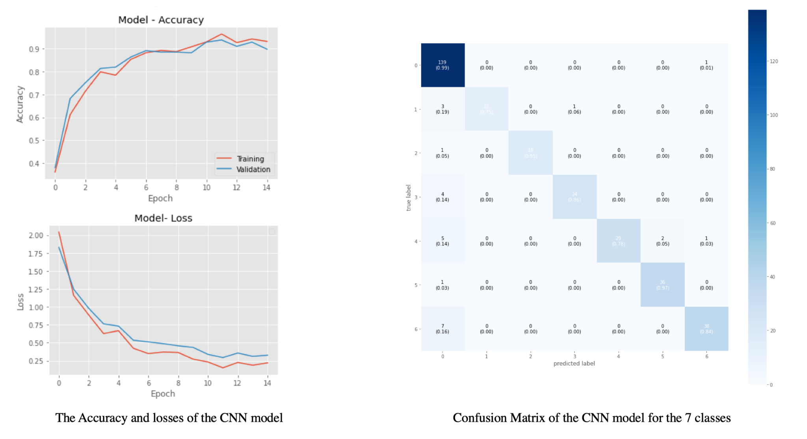
CNN / Results
9 | BMEN 4470
Notes:
Heart disease is one of the most pervasive causes of human death. The diagnosis of heart disease is a challenging task. In a clinical mannar, doctors usually diagnose it based on the morphological waveform of an ECG. The waveforms in an ECG can be divided into time segments measuring particular phases of the cardiac cycle or contraction. The continuous repetitive unit of the cardiac cycle is the “P-QRS-T” waveforms.
However, the diagnosis of heart disease is difficult because of its paroxysmal and complex nature. And it is usually difficult to make a clinical judgement, especially when the signals are mixed with noise.
This leads to the development of machine learning approaches to accurately identify heart disease.
ECG: a time series of data, and a recurrent neural network (RNN) can be used to solve the time-series problem.
Electrocardiogram (ECG): a technique for graphical representation of heart activity over time. An ECG reflects the regularity of the heart’s activity and physiological state of each body part.
ECG is a significant reference for the diagnosis of heart disease.
The waveforms depicted in an EKG can be divided into time segments measuring particular phases of the cardiac cycle or contraction. The continuous repetitive unit of the cardiac cycle is the “P-QRS-T” waveforms.
9

Slide 10
Conclusion
10 | BMEN 4470
Notes:
Heart disease is one of the most pervasive causes of human death. The diagnosis of heart disease is a challenging task. In a clinical mannar, doctors usually diagnose it based on the morphological waveform of an ECG. The waveforms in an ECG can be divided into time segments measuring particular phases of the cardiac cycle or contraction. The continuous repetitive unit of the cardiac cycle is the “P-QRS-T” waveforms.
However, the diagnosis of heart disease is difficult because of its paroxysmal and complex nature. And it is usually difficult to make a clinical judgement, especially when the signals are mixed with noise.
This leads to the development of machine learning approaches to accurately identify heart disease.
ECG: a time series of data, and a recurrent neural network (RNN) can be used to solve the time-series problem.
Electrocardiogram (ECG): a technique for graphical representation of heart activity over time. An ECG reflects the regularity of the heart’s activity and physiological state of each body part.
ECG is a significant reference for the diagnosis of heart disease.
The waveforms depicted in an EKG can be divided into time segments measuring particular phases of the cardiac cycle or contraction. The continuous repetitive unit of the cardiac cycle is the “P-QRS-T” waveforms.
10

Slide 11
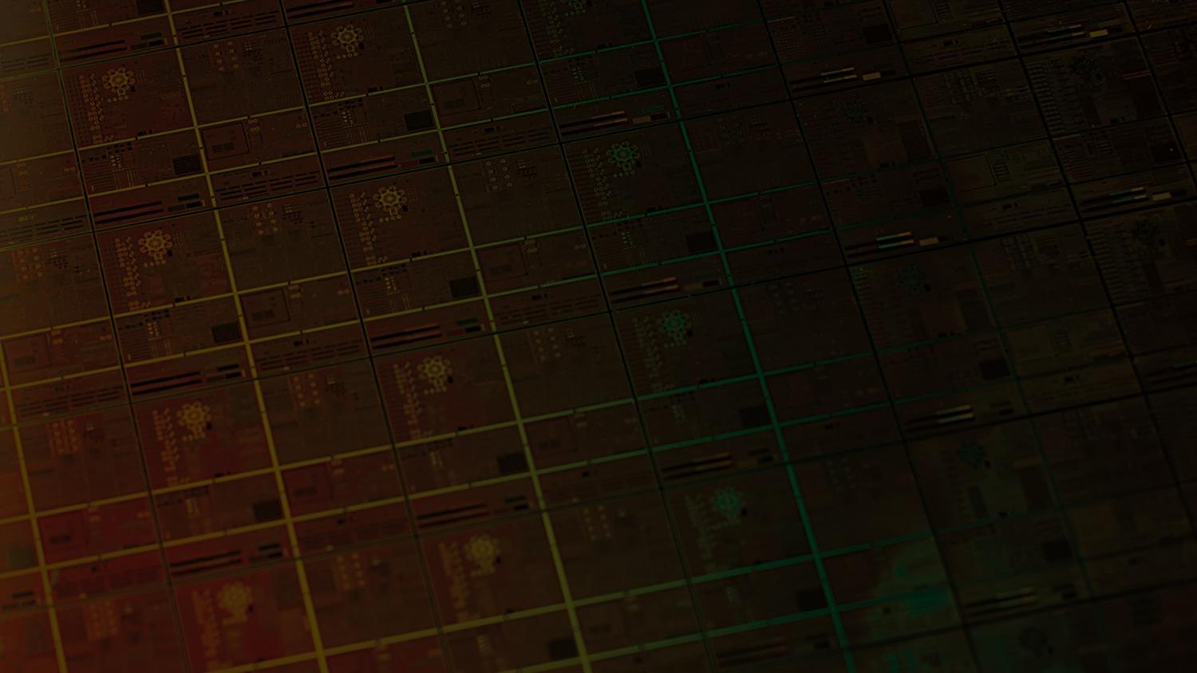
Thank you!
11 | BMEN 4470
Notes:
11

